Slide 1

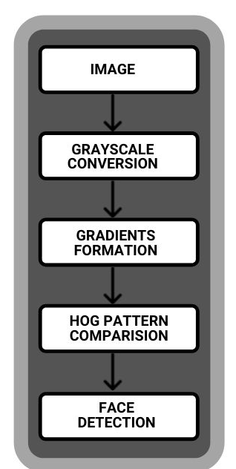
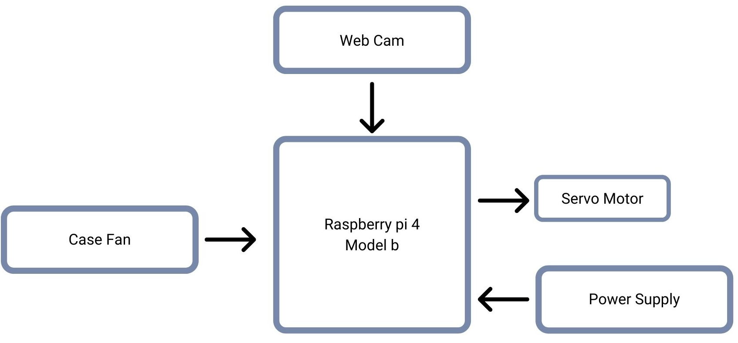
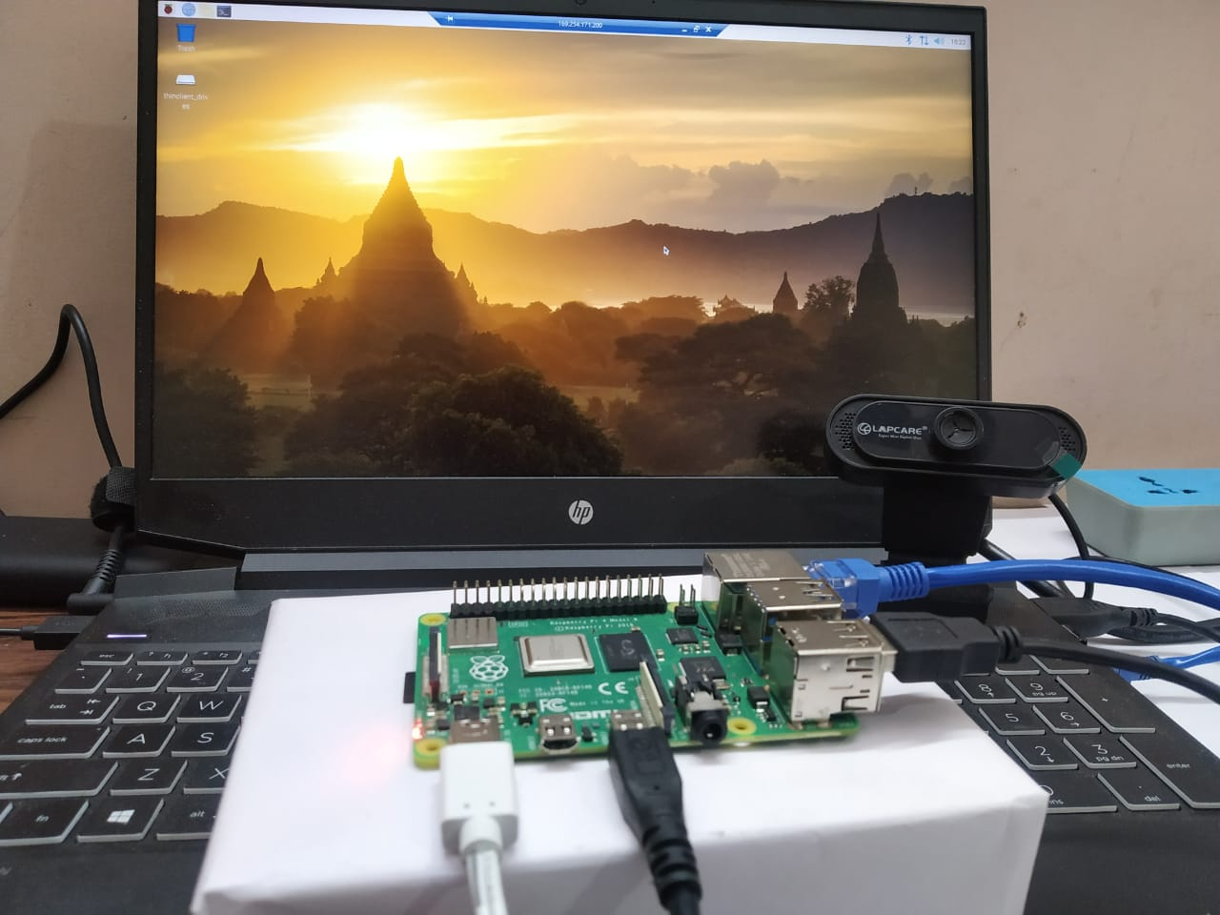
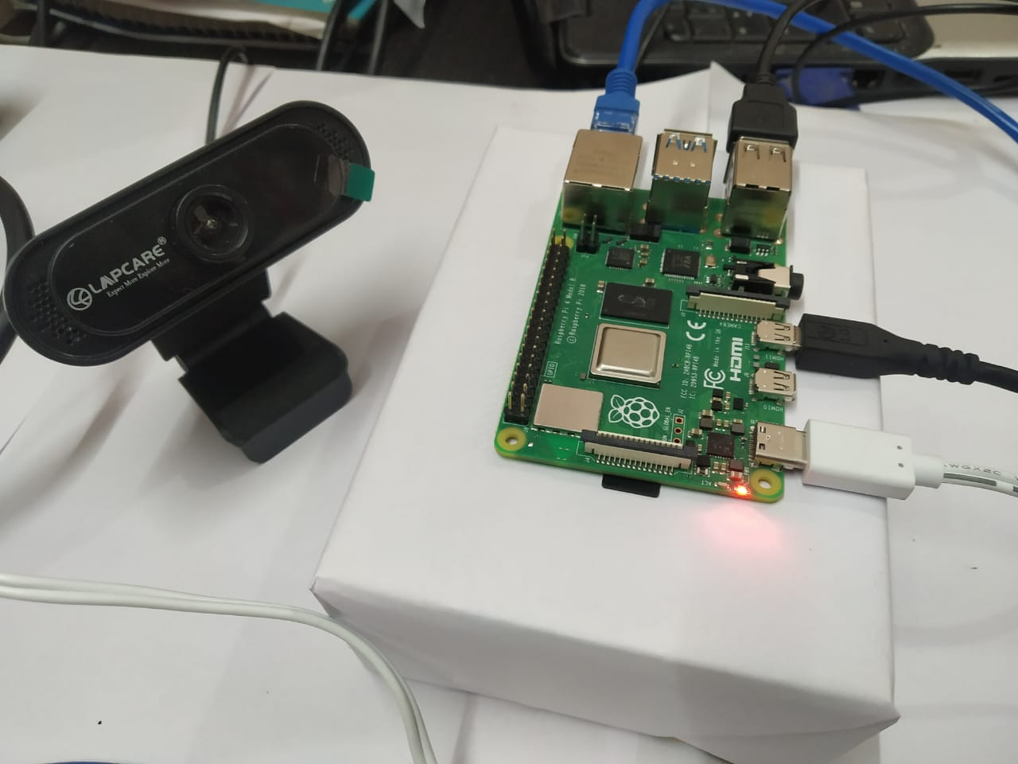
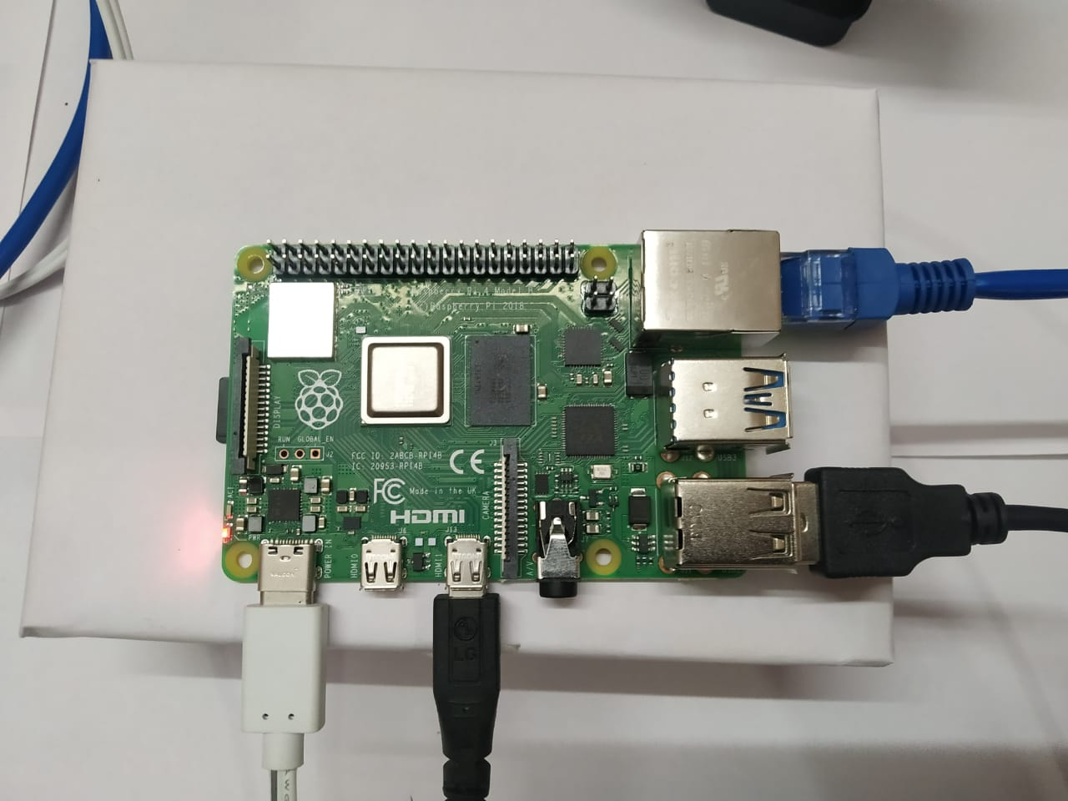
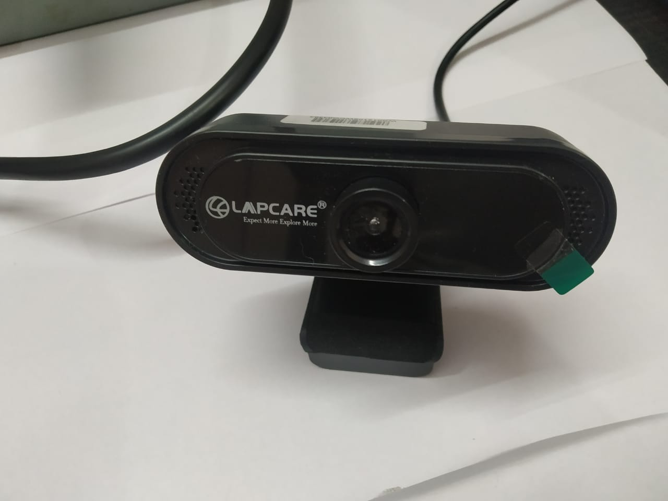
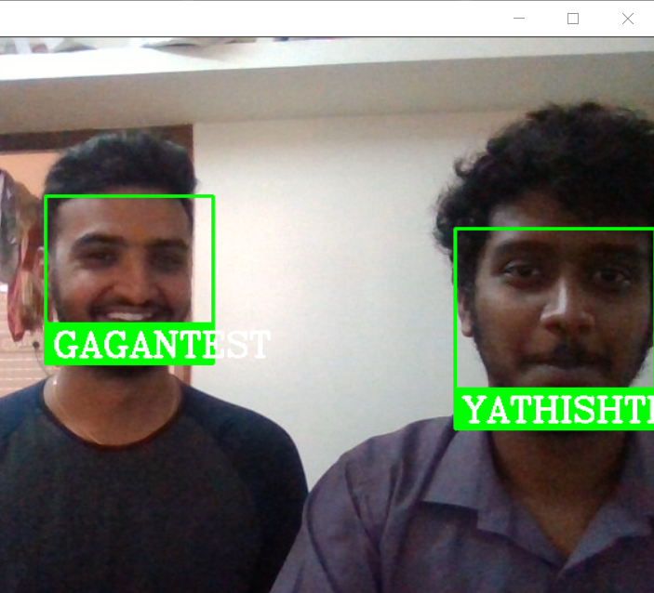
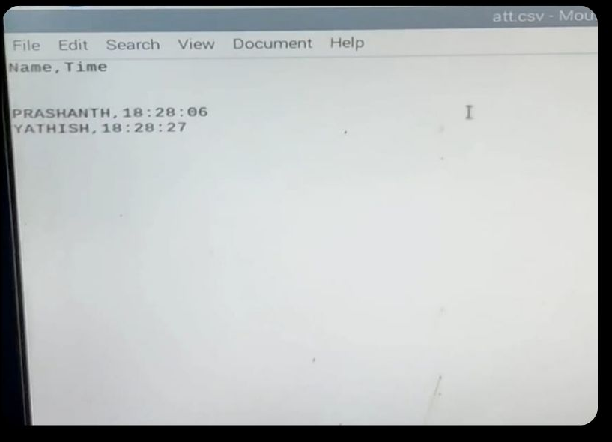
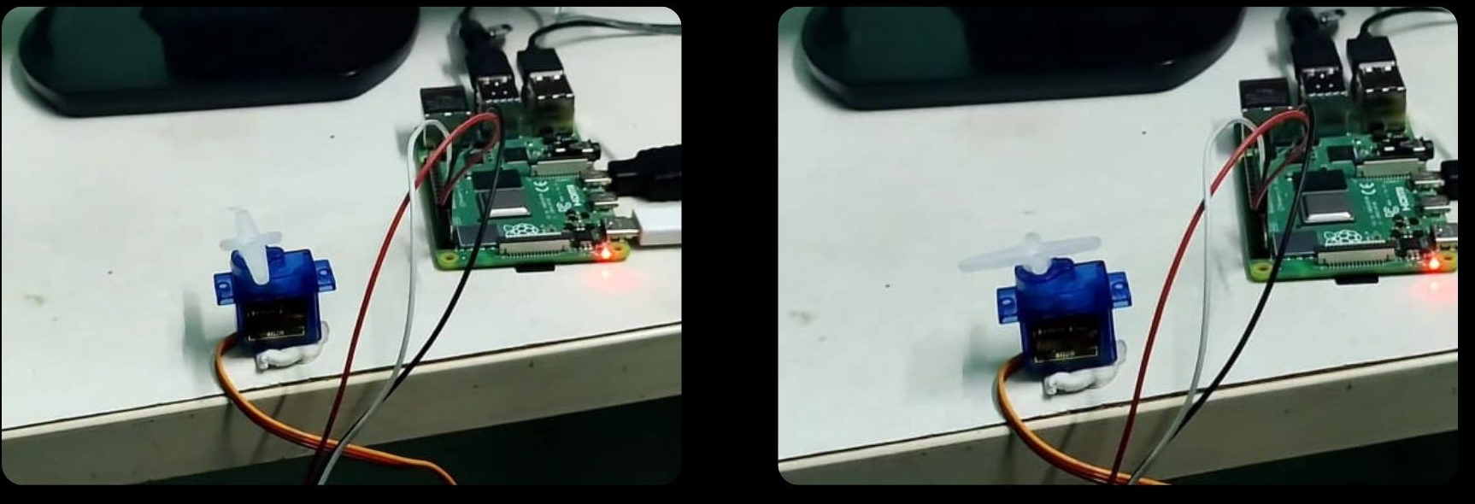
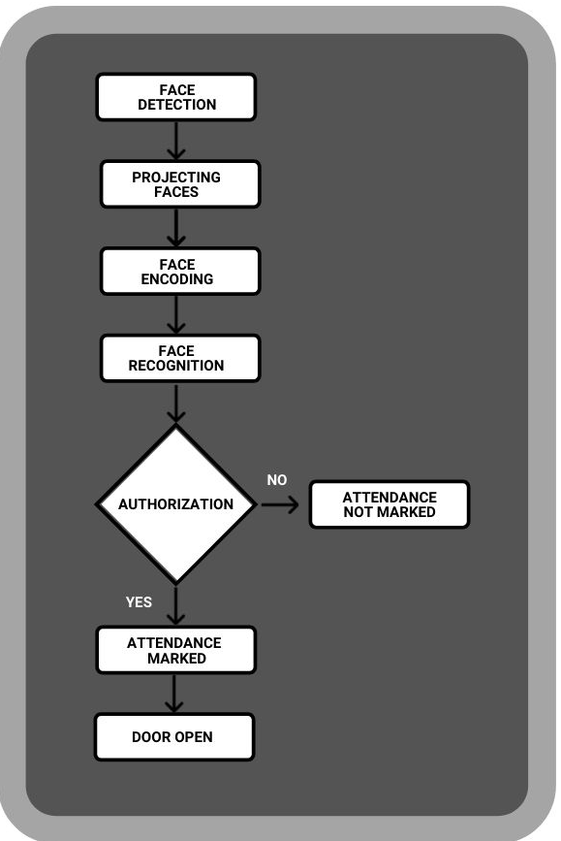
Smart Door and Attendance system using Image Processing
Open Day Exhibition -2021,Department of Telecommunication Engineering
Arun Kumar HS, Gagandeep K ,Prashanth Kumar KM, Yathish S, Dr. Deepthi Raj
Batch Number: B16
Introduction :
Human face plays an important role in our day-to-day life mostly for identification of a person. Face recognition is a part of biometric identification that extracts the facial features of a face, and then stores it as a unique face print, to uniquely recognize a person. Biometric face recognition technology has gained the attention of many researchers because of its wide application. Face recognition technology is better than other biometric based recognition techniques like finger-print, palm-print, iris because of its non-contact process. Recognition techniques using face recognition can also recognize a person from a distance, without any contact or interaction with person. The face recognition techniques are currently implemented in social media websites like Facebook, at the airports, railway stations.
Samples of Figures and Tables
Figure 1. HOG Methodology, Block diagram
Results :
Objective :
The main objective is to build a smart door and attendance system using image processing.
Components :
HARDWARE: Raspberry Pi 4 model b, webcam, servo moor
SOFTWARE : Python 3.7, Face Recognition, Raspbian(os), Thonny(IDE), Computer Vision.
Firstly, Face is detected using HOG (Histogram of Gradients) method, then faces are projected or aligned to the center as much as possible using the 68 landmarks. Now the next step would be finding out the encodings of face, that is generating the measurements of face present in front of the camera frame. Then these encodings are compared with the pre-generated encodings of the face with labels. If the face is recognized as an authorized face, the attendance is marked in a separate CSV file. When the attendance is marked the door is automatically opened and closed after few seconds
Application :
It can be used in public buildings like hospitals, schools, high security buildings.
It can be used during state elections to verify the voters and maintain a record of the voters to overcome vote rigging.
Methodology :
Flow Chart

